Slide 1
Memory Management strategies

Slide 2
Objectives
To provide a detailed description of various ways of organizing memory hardware
To discuss various memory-management techniques, including paging and segmentation
To provide a detailed description of the Intel Pentium, which supports both pure segmentation and segmentation with paging

Slide 3
Memory Management
Is the task carried out by the OS and hardware to accommodate multiple processes in main memory
If only a few processes can be kept in main memory, then much of the time all processes will be waiting for I/O and the CPU will be idle
Hence, memory needs to be allocated efficiently in order to pack as many processes into memory as possible

Slide 4
Why ?
The multi-programming concept of an OS gives rise to another issue known as memory management.
Memory, as a resource, needs to be partitioned and allocated to the ready processes, such that both processor and memory can be utilized
efficiently.
It is partitioned into two parts; one for the OS, and the other for the user area

Slide 5
The user area needs to be divided into multiple parts for various user processes.
This division of memory for processes needs proper management, including its efficient allocation and protection.
Memory management needs hardware support
also, therefore, the management technique also
depends on the hardware available.
The memory management issue extends from
basic memory management techniques to virtual memory management, in order to meet the challenge of huge memory requirements of processes

Slide 6
Therefore, there are two types of memory
management:
real memory(main memory) and
virtual memory

Slide 7
Static and Dynamic Allocation
Memory allocation is generally performed
through two methods:
static allocation and
dynamic allocation.

Slide 8
In static allocation, the allocation is done before the execution of a process. There are two instances when this type of allocation is performed:
1. When the location of the process in the memory is known at compile time, the compiler generates an absolute code for the process.
If the location of the process needs to be changed on the memory, the code must be recompiled.

Slide 9
2. When the location of the process in the memory is not known at compile time, the compiler does not produce an actual memory address but generates a relocatable code, that is, the addresses that are relative to some known point.
With this relocatable code, it is easy to load the process to a changed location and there is no need to recompile the code.
In both cases of static allocation, size should be known before start of the execution of the process.

Slide 10
Dynamic Allocation
If memory allocation is deferred till the process starts executing, it is known as dynamic allocation
It means the process is loaded in memory initially with all the memory references in relative form.
The absolute addresses in memory are calculated as an instruction in the process is executed.

Slide 11
Memory Management Requirements
Relocation
programmer cannot know where the program will be placed in memory when it is executed
a process may be (often) relocated in main memory due to swapping
swapping enables the OS to have a larger pool of ready-to-execute processes
memory references in code (for both instructions and data) must be translated to actual physical memory address

Slide 12
Memory Management Requirements
Protection
processes should not be able to reference memory locations in another process without permission
impossible to check addresses at compile time in programs since the program could be relocated
address references must be checked at run time by hardware

Slide 13
Memory Management Requirements
Sharing
must allow several processes to access a common portion of main memory without compromising protection
cooperating processes may need to share access to the same data structure
better to allow each process to access the same copy of the program rather than have their own separate copy

Slide 14
Memory Management Requirements
Logical Organization
users write programs in modules with different characteristics
instruction modules are execute-only
data modules are either read-only or read/write
some modules are private others are public
To effectively deal with user programs, the OS and hardware should support a basic form of module to provide the required protection and sharing

Slide 15
Memory Management Requirements
Physical Organization
secondary memory is the long term store for programs and data while main memory holds program and data currently in use
moving information between these two levels of memory is a major concern of memory management (OS)
it is highly inefficient to leave this responsibility to the application programmer

Slide 16
Address Binding
Usually a program resides on a disk
To be executed it must be brought into memory
Processes on disk which are waiting to be brought into memory for execution forms the input queue

Slide 17
The binding of instructions and data to memory
addresses can be done at any step along the way:
Compile time : if you know at compile time where the process will reside in memory. Then absolute code can be generated
Load time : if it is not known at compile time where the process will reside in memory, then the compiler must generate relocatable code
Execution time: if the process can be moved during its execution from one memory segment to another, then binding must be delayed until run time.

Slide 18
Logical vs. Physical Address Space
The concept of a logical address space that is bound to a separate physical address space is central to proper memory management
Logical address – generated by the CPU; also referred to as virtual address
Physical address – address seen by the memory unit
Logical and physical addresses are the same in compile-time and load-time address-binding schemes; logical (virtual) and physical addresses differ in execution-time address-binding scheme
Logical address space is the set of all logical addresses generated by a program
Physical address space is the set of all physical addresses generated by a program

Slide 19
Swapping
Swapping was introduced in concern with suspended processes.
Swapping plays an important role in memory management.
There are some instances in multi-programming when there is no memory for executing a new process.
In this case, if a process is taken out of memory, there will be space for a new process.
This is a good solution, but the following factors matter during the implementation.
Where will this process reside?
Which process will be taken out?
Where in the memory will the process be brought back?

Slide 20
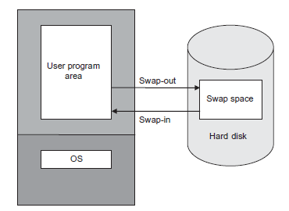
help of any secondary storage (generally, hard disk) known as backing store, is taken, and the process is stored there.
A separate space in the hard disk, known as swap space, is reserved for swapped-out processes.
Swapping incurs the cost of
implementation

Slide 21
Example:
A process of size 200 MB needs to be swapped into
the hard disk. But there is no space in memory.
A process of size 250 MB is lying idle in memory and
therefore, it can be swapped out. How much swap
time is required to swap-in and swap-out the
processes if:
Average latency time of hard disk = 10 ms
Transfer rate of hard disk = 60 MB/s

Slide 22
Solution
The transfer time of the process to be swapped into hard disk = 200/60 = 3.34 s. = 3340 ms
Therefore, the swap time of 200 MB process = 3340 +10 = 3350 ms
The transfer time of the process to be swapped-out from memory = 250/60 = 4.17 s. = 4170 ms
Therefore, the swap time of 250 MB process = 4170 +10 = 4180 ms
Total swap time = 3350 + 4180 = 7530 ms

Slide 23
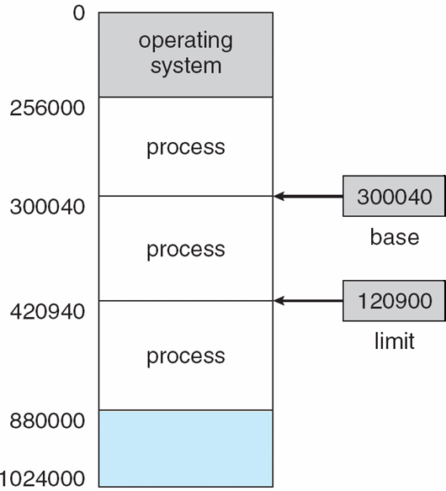
Relocation: Base and Limit Registers
A pair of base and limit registers define the logical address space
CPU must check every memory access generated in user mode to be sure it is between base and limit for that user

Slide 24
Hardware Address Protection with Base and Limit Registers

Slide 25
Example :
A process is to be swapped-in at the location 20100 in memory. If logical addresses generated
by the process are 200, 345, 440, and 550, what are the corresponding physical addresses?

Slide 26
Solution
The relocation register will be loaded with the address
20100. So adding the logical addresses to the
relocation register, the corresponding physical
addresses are as follows:
20100 + 200 = 20300
20100 + 345 = 20445
20100 + 440 = 20540
20100 + 550 = 20650

Slide 27
Example:
A process has relocatable code of size of 900 K. The relocation register is loaded with 40020 K and the limit register contains the address 41000 K. If the processor generates a logical address 990, where will it be located in the physical memory?

Slide 28
Fixed and Variable Memory Partitioning
The memory space is divided into fixed or variable partitions
Fixed partitioning is a method of partitioning the memory at the time of system generation.
In fixed partitioning, the partition size can be of fixed size as well as variable, but once fixed, it cannot be changed.
Variable partitioning is not performed at the system generation time. In this partitioning, the number and size of the memory partition vary
and are created at run time, by the OS.

Slide 29
Fragmentation
When a process is allocated to a partition, it may be possible that its size is less than the size of partition, leaving a space after allocation, which is unusable by any other process. This wastage of memory, internal to a partition, is known as internal fragmentation.

Slide 30
While allocating and de-allocating memory to the
processes in partitions through various methods, it
may be possible that there are small spaces left in
various partitions throughout the memory, such
that if these spaces are combined, they may satisfy
some other process’ request.
But these spaces cannot be combined. This total
memory space fragmented, external to all the
partitions, is known as external fragmentation.

Slide 31
Internal Fragmentation : allocated memory may be slightly larger than requested memory; this size difference in memory internal to a partition, but not being used
External fragmentation : total memory space exists to satisfy a request , but it is not contiguous

Slide 32
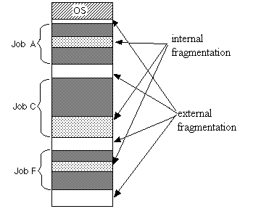

Slide 33
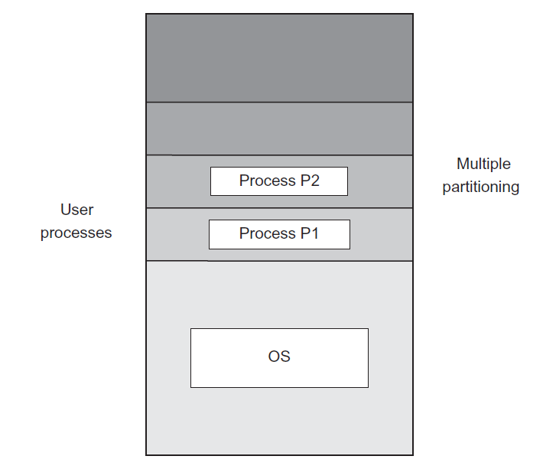
Contiguous Memory Allocation
The contiguous allocation method was implemented by partitioning the memory into various regions.
The memory can be partitioned, using either fixed memory or variable memory partitioning.

Slide 34
In this method, a process is allocated a contiguous memory in a single partition.
Thus, the memory partition, which fits the process, is searched and allocated.
The memory partition, which is free to allocate, is known as a hole.

Slide 35
Contiguous Allocation with Fixed Partitioning
Fixed partitioning is a method of memory partitioning at the time of system generation.
The partition can be of fixed as well as variable size, but once fixed, it cannot be changed

Slide 36
Example
Three processes P1, P2, and P3 of size 21900, 21950, and 21990 bytes, respectively, need space in the memory. If equal-sized partitions of 22000 bytes are allocated to P1, P2, and P3, will there be any fragmentation in this allocation?

Slide 37
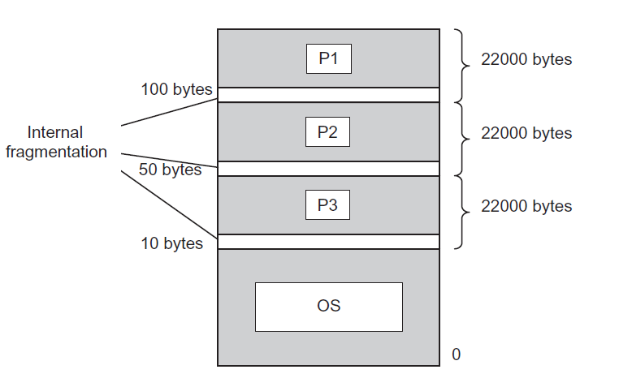
Solution
After allocating the partitions to the processes, the leftover space in each partition is estimated by the difference between partition size and process size. Hence,
The leftover space in the first partition = 22000 – 21900 = 100 bytes
The leftover space in the second partition = 22000 – 21950 = 50 bytes
The leftover space in the third partition = 22000 – 21990 = 10 bytes.
This leftover space in each partition is nothing but internal fragmentation, as shown in the following figure:

